Slide 1
VLAN & VTP
Course Code: COE 3206
Course Title: Computer Networks
Dept. of Computer Science
Faculty of Science and Technology
Lecturer No: | 9 | Week No: | 11 | Semester: | Summer 23-24
Lecturer: | Md. Faruk Abdullah Al Sohan; faruk.sohan@aiub.edu

Slide 2
Lecture Outline
Configuring VLANs
VTP Configuration

Slide 3
Configuring VLANs
Introduction
A technique of logically grouping of computers of LAN to limit broadcast
domain and improve security.
Each VLAN must have a LAN number → Valid numbers are 1 to 4094
Normal VLANS 1 to 1005
Stored in in vlan.dat file of Flash memory
Normally used
Extended VLANS 1006 to 4094
Stored in running configuration file
Limited options
Factory set VLANs (cannot be changed)
VLAN 1 ---Administrative VLAN or default VLAN (for Cisco switch)
VLAN 1001 to 1005 used for Token ring and FDDI networks (Not used usually)
VLAN name is optional [1]

Slide 4
Configuring VLANs….
Creation of VLANs
All configuration must be done in Global Configuration mode
VLAN Creation
# enable to access privileged exec mode.
# configure terminal to access global configuration mode.
# vlan 2 to create VLAN 2 and access VLAN configuration mode.
# name Production to name this VLAN Production.
# vlan 3 to create VLAN 3.
# name HR to name this VLAN HR [1].
Verify VLAN creation
show vlan brief

Slide 5
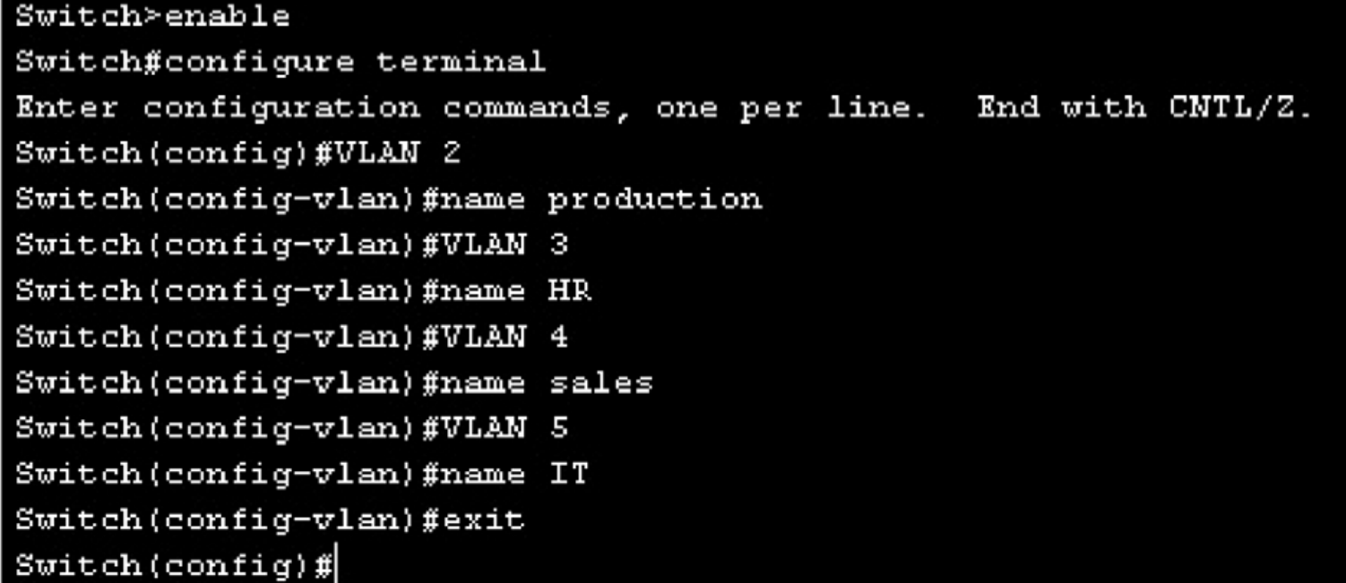
Configuring VLANs….
Cisco IOS commands for creating four VLANs

Slide 6
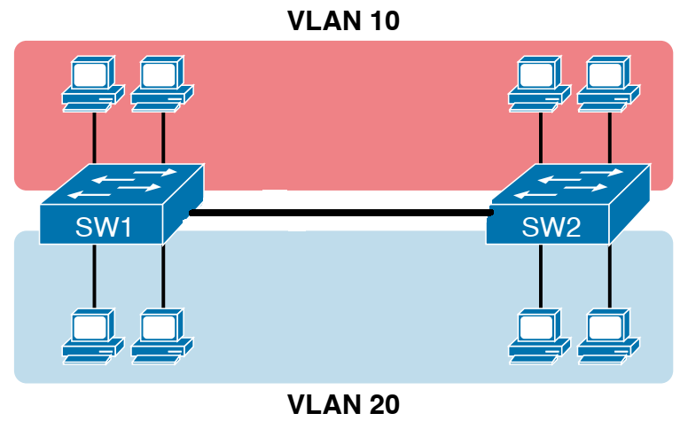
Configuring VLANs….
Modes of Interfaces
Access
Used to connect an end device such as PC
Trunk
Used to connect a connecting device such as another switch or a router to
carry data for multiple VLANs
Access
Trunk if it is configured to carry
data of multiple VLANs

Slide 7
Configuring VLANs….
Topic sub heading..
Adding interface to a VLAN
# enable to access privileged exec mode.
# configure terminal to access global configuration mode.
# interface fa0/1 to access FastEthernet port 0/1.
# switchport mode access to set this port into a nontrunking access mode.
# switchport access vlan 2 to set this port to use VLAN 2.
# interface fa0/2 to access FastEthernet port 0/2.
# switchport mode access to set this port into a nontrunking access mode.
# switchport access vlan 3 to set this port to use VLAN 3
# interface fa0/3 to access FastEthernet port 0/3
# switchport mode trunk to set this port into a trunking mode

Slide 8
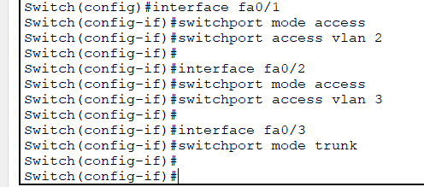
Configuring VLANs….
Commands for adding interfaces to a VLAN

Slide 9
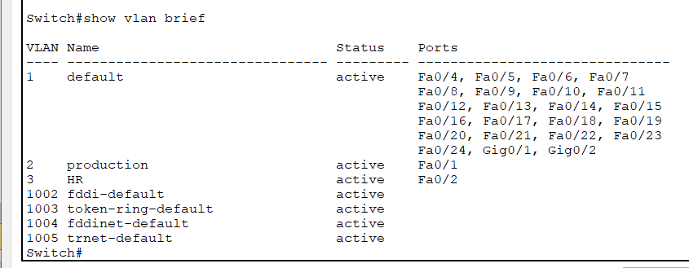
Configuring VLANs….
Verify members of a VLAN
Fa0/3
is not
shown
as it is
a trunk

Slide 10
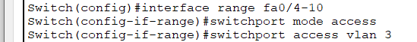
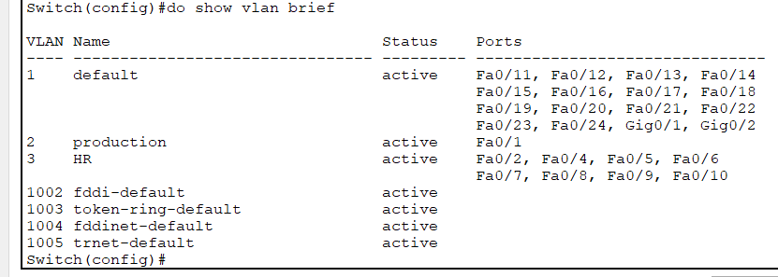
Configuring VLANs….
Adding multiple interfaces to a VLAN at a time
Adding multiple interfaces to a VLAN at a time

Slide 11
Configuring VLANs….
Verifying VLAN Information
Switch# show vlan | Displays VLAN information
Switch# show vlan brief | Displays VLAN information in brief
Switch# show vlan id 2 | Displays information about VLAN 2 only
Switch# show vlan name HR | Displays information about VLAN HR only

Slide 12
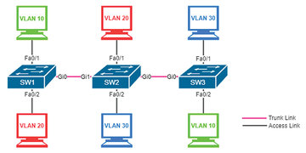
VTP Configuration
VTP configuration commands
Suppose
SW1: Sever
SW2 & SW3: Client
A
B
C
SW1
Switch(config)# vtp mode server
Switch(config)# vtp domain aiub
Switch(config)# vtp password 123
D
E
F
SW2
SW3
Switch(config)# vtp mode client
Switch(config)# vtp domain aiub
Switch(config)# vtp password 123
Switch(config)# vtp mode client
Switch(config)# vtp domain aiub
Switch(config)# vtp password 123

Slide 13
Topic Heading..
VTP configuration verification
Verifying VTP
Switch# show vtp status | Displays general information about VTP configuration
Switch# show vtp counters | Displays the VTP counters for the switch

Slide 14
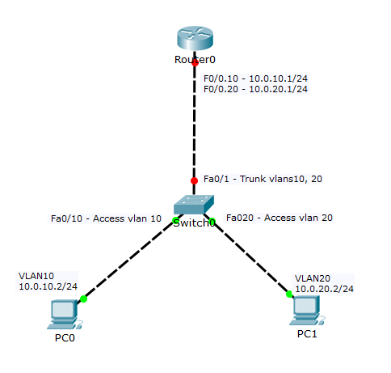
router on stick

Slide 15
References
[1] D. Liu, Cisco CCNA/CCENT Exam 640-802, 640-822, 640-816 Preparation Kit, Syngress
Publishing, Inc., 2009, pp. 549-567.
[2] W. Odom, Official Cert Guide CCNA 200-301 Volume 1, Pearson Education, Inc.,
2020, USA, p. 181.

Slide 16
Books
1. Official Cert Guide CCNA 200-301 , vol. 1, W. Odom, Cisco Press, First Edition, 2019, USA.
2. CCNA Routing and Switching, T. Lammle, John Wily & Sons, Second Edition, 2016, USA.

